Slide 1
Virtual Personal Assistant
Presented by Sagar mandiya, Samay pashine and Praveen Gupta

Slide 2
Content:
1. Introduction.
2. Basic Concepts Used.
3. Comparison Between Popular Ones.
4. VPAs in Future.
5. Conclusion.
6. References

Slide 3
Aim
Our digital assistant name claira
our main objectives to a build a personal digital assistant which work offline

Slide 4
Introduction:
What is Virtual Personal Assistant?
Virtual personal assistant is just like the our software agent who does work for you under your command.
What Concept of an artificial personal assistant?
A virtual assistant also called AI assistance that can interpret natural language and complete the task of user through voice commands.
Is Voice-controlled Personal Digital Assistants?
A digital assistant typically operates from a home office but can access the necessary planning documents, such as shared calendars, remotely.
The combination of :
Automatic Speech Recognition.
Artificial Intelligence.
Natural Language Processing.
Inter Process Communication.

Slide 5
Basic Concepts Used:
The working of Virtual Assistant uses following principles:
Natural Language Processing.
To Understand user’s speech input.
Automatic Speech Recognition.
To understand command according to user’s input.
Artificial Intelligence.
To learn things from user and to store all
Information bout behavior and relations of user
Inter Process Communication.
To get important information from
other software applications.

Slide 6
Working:
Any Virtual Assistant basically consists of three layers.
1. Speech to text
2. Text Analysing
3. Interpret commands

Slide 7
Working Three layers:
1. Speech to text:
A Piece of software used that converts audio to text.
It doesn’t understand just anything you might say.
2. Text Analysing:
Converted text is just letters for computer.
A piece of software converts text to something that is understandable for computer.
Computer understands the command, so Virtual Assistant like siri convert this text to computer command.

Slide 8
VPAs maps the words to functions and parameters to create a command that computer can understand.
Example of Reminder.
3. Interpret commands:
In this layer, that mapped computer command, go to server through internet.

Slide 9
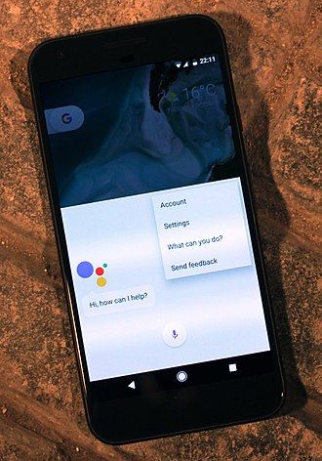
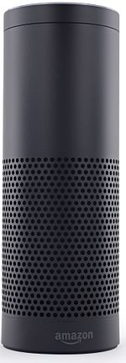
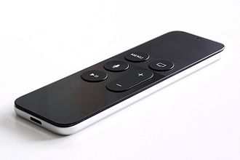
Available Applications:
Google Assistant
Microsoft Cortana
Apple Siri
Amazon Alexa
Robin

Slide 10
Advantages and Disadvantages:
Advantages:
These applications make small and smart hand-held devices to combine multiple features.
They allow you to export and import data.
Make to do lists and Recognizes voice commands
Controls various applications of device.
Disadvantages:
Listening problem.
Silent mode support.
VPA gives response in voice output thus it doesn’t work properly in silent mode.Controls various applications of device.

Slide 11
Conclusion:
Virtual Personal Assistants are very effective way to organize your schedule. Now there are many Smart Personal Digital Assistant applications available in market for various device platforms. These new Software Applications are performing really well than PDA devices as they provided with all resources of your smartphone. VPAs are also reliable than Human Personal Assistant because, VPAs are more portable and you can use them anytime. They also have lot of information than any assistant as they are connected with internet.

